Slide 1
ISTD 50.001
Data Analytics for Internet of Things (IoT)

Slide 2
IoT Components
Sensing
Communication (wireless)
Data analytics

Slide 3
Data Analytics
Classification
Given a new observation as input, predict the class / category that the observation belongs to
  Based on an email header / content, predict if it is a spam or not
  Based on the student’s body temperature, heart-rate, predict if the student is under stress
Regression
Given a new observation as input, predict the real-value output for the input
  Given the profits of a company in the previous years, predict the profit of the company in this year
  Based on student’s quizzes score, predict his/her exam score

Slide 4
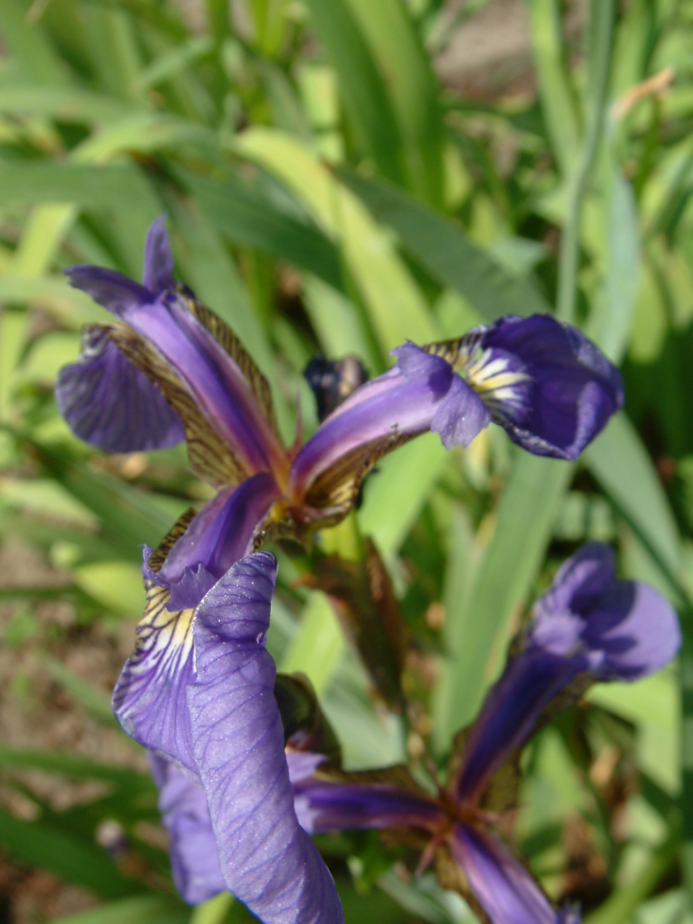
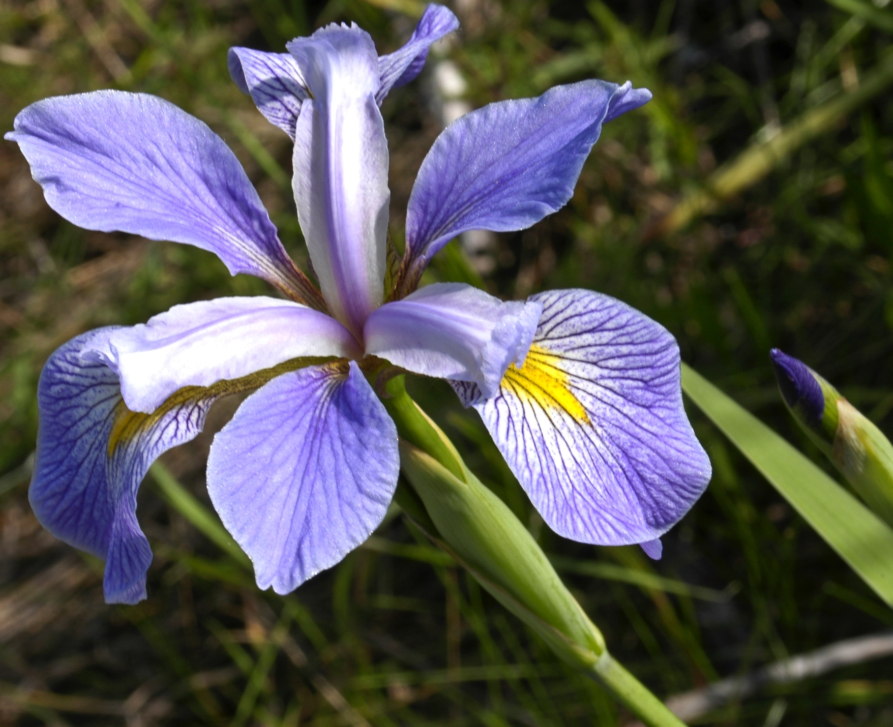
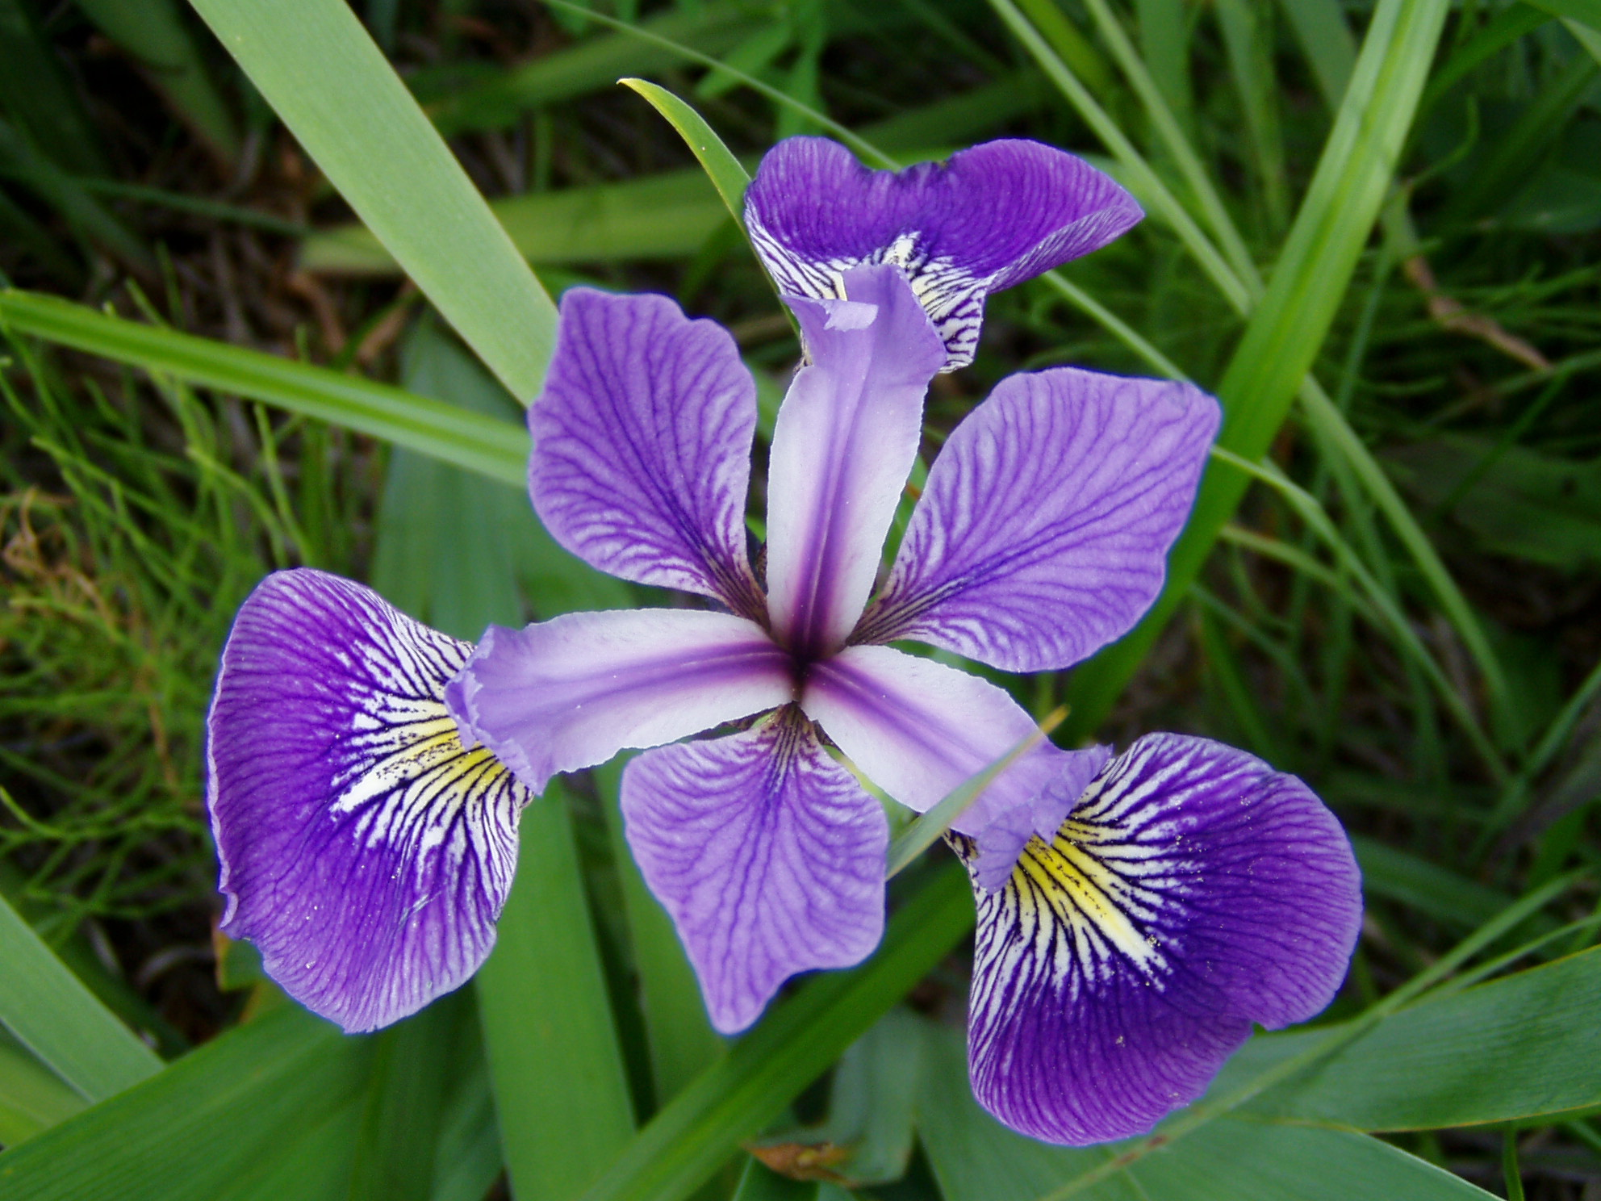
Classification Problem: An Example
Classify the Iris flower species: Iris setosa, Iris virginica and Iris versicolor
How to classify a new observation?

Slide 5
Classification Problem: An Example
Classify the Iris flower species: Iris setosa, Iris virginica and Iris versicolor
Color? Size? Height? Smell? Petal area?
-We analyze the new observation based on a set of quantifiable properties (features, attributes, explanatory variables)
-Different types of quantifiable properties
  -Categorical: “yellow”, “purple”, “green”
  -Ordinal: “large”, “medium”, “small”
  -Real-valued: 11.3 cm, 8.7 cm

Slide 6
Classification: General Steps
Observations / instances
Features / attributes
Training (usually offline)
Observations with know class information
Extract attributes / features
Learn a model using some algorithm
A model for this specific classification problem and classifier
Testing (usually online)
New observation with unknown class information
Extract attributes / features
Classifier algorithm
Predicted class information for this new observation

Slide 7
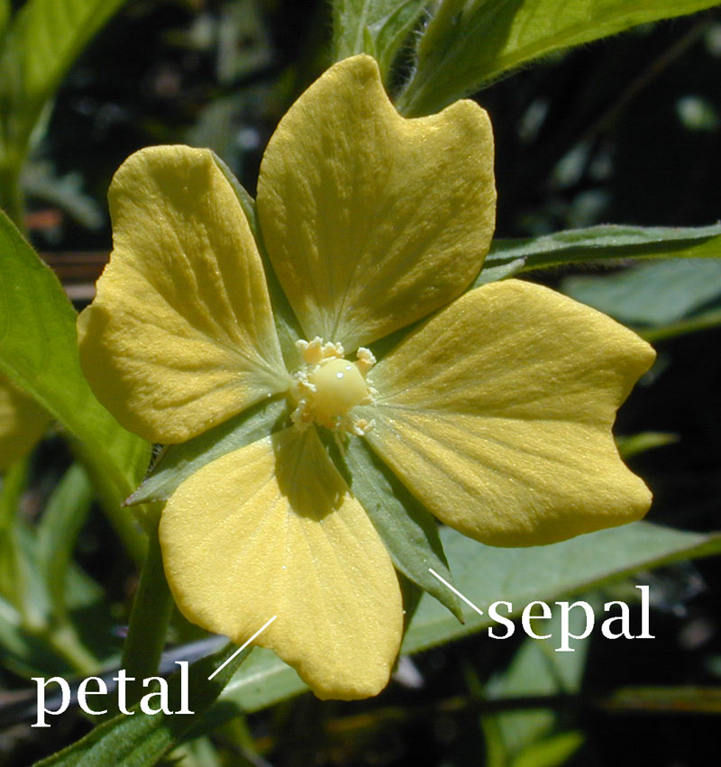
Feature / Attribute Extraction
Good attributes provide discriminative information to determine the class / category
May require in-depth domain knowledge
  E.g., attribute to classify cancerous / non-cancerous
Quantifiable
Measurable
For Iris classification, it has been recognized that the length / width of the sepals and petals are good attributes

Slide 8
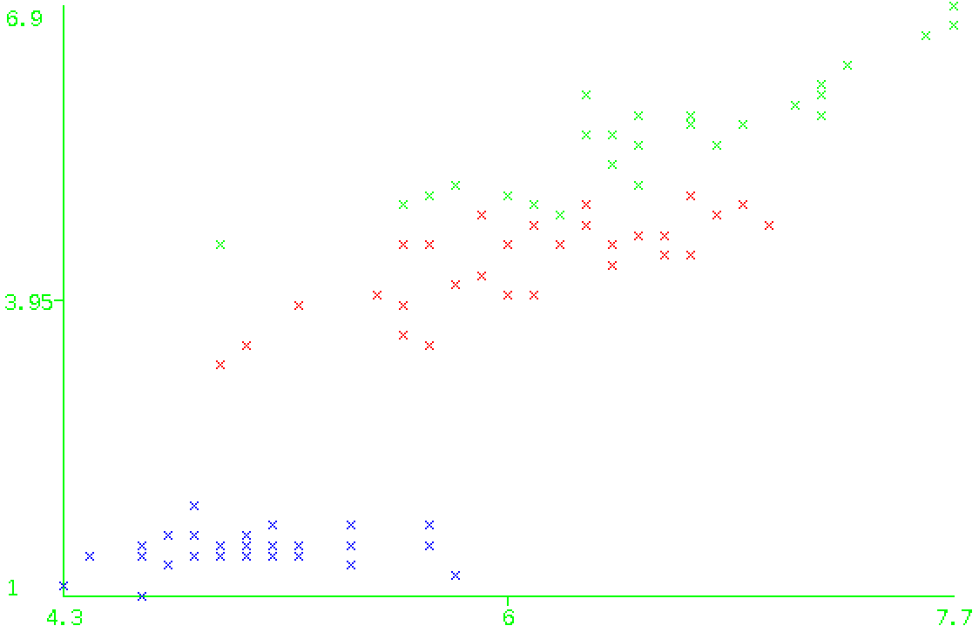
Feature / Attribute Space
Feature vector: An n-dimensional vector of numerical features that represents an instance, with n being the number of features
Feature space: A vector space associated with the feature vector
Petal length
(should be a 4-dim feature space)
Sepal length

Slide 9
k-Nearest Neighbors Classifier:
An Example of Classifier Algorithm
Classify a new instance using majority vote of its neighbor
The instance is assigned to the class which is most common among its k nearest neighbors

Slide 10
Common Machine Learning / Data Mining Software
Weka
  Provide both GUI application and Java API
RapidMiner
Matlab toolbox
R
…

